Slide 1
Network and Computer Security
Chapter 5 – Software and system security
Prof. dr. ir. Eli De Poorter
© Eli De Poorter

Slide 2
Overview
Secure systems
  Authentication methods
    Passwords
    Biometry
    Security Tokens
  Trusted OS
  Disk encryption
Notes:
Different methods exist to authenticating an entity requesting access to system. Typically, certificate based methods (Kerberos, X509) are not directly suitable for user logins into local systems.

Slide 3
Passwords
Most commonly used authentication method
  Access to computer (system)
  Access to websites
  PIN code for payment cards
  Etc.
Passwords are typically stored as a hash digest, rather than storing the actual password
  Password inputs are hashed, then compared with the hash stored in the system
  Prevents password losses in case the system is compromised
Notes:
Storing all user passwords as cleartext can result in a massive security breach if the password file is compromised. One way to reduce this danger is to only store the hash digest of each password. To authenticate a user, the password presented by the user is hashed and compared with the stored hash. Note that this approach prevents the original passwords from being retrieved if forgotten or lost, and they have to be replaced with new ones.

Slide 4
Passwords
Advantages
  Simplicity
    Simpler implementation than complex cryptographic protocols
  Reasonable degree of security
    With well-chosen passwords
    With secure implementation
      Storage, communication, etc.
    With well-considered use
Notes:
A good password shouldn’t be easy to guess for a potential attacker. A secure implementation implies e.g. that a password shouldn’t be stored or communicated in plaintext (certainly not over an ill-secured wireless connection). However, transmitting a password over an SSH or SSL/TLS connection is acceptable. A password shouldn’t be simply written down, although secure storage of passwords (e.g. using PGP) can be justified. When typing passwords one should also take care for possible “shoulder surfing” (think twice about this when you’re typing your password on a smartphone or tablet). Don’t use passwords for potentially unsecured or ill-secured applications (logging in at non-critical websites, unsecure POP-retrieval of e-mail, etc.) for applications where communication is secure (and reliable). The system on which a password is used should also be secured against other threats such as “keyloggers” (malware registering keyboard input), but this system security is also a requirement for many other security mechanisms.

Slide 5
Passwords
Drawbacks
  Complexity
    Remembering 1 password is reasonably easy, but remembering dozens of passwords is hell
    It isn’t recommended to use the same password for all applications
  High degree of vulnerability
    With ill-chosen passwords
    With insecure implementation
      Storage, communication, etc.
    With careless use

Slide 6
Password cracking
Motivations
  For retrieving lost passwords
  For unauthorized entrance
  For security checking
Example attacks
  Brute-force attack
  Dictionary attack
  Hash chains
  Rainbow table
Often performed by distributed botnets
Notes:
In cryptanalysis and computer security, password cracking is the process of recovering passwords from data that have been stored in or transmitted by a computer system. The purpose of password cracking might be to help a user recover a forgotten password (installing an entirely new password is less of a security risk, but it involves System Administration privileges), to gain unauthorized access to a system, or as a preventive measure by System Administrators to check for easily crackable passwords.

Slide 7
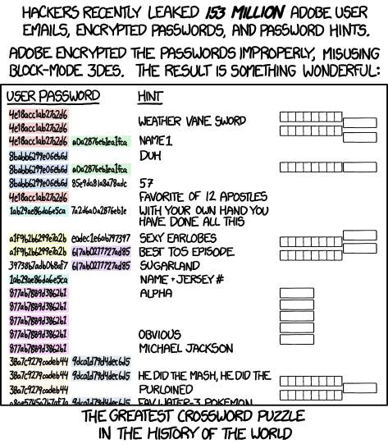

Password cracking
http://xkcd.com/1286/
Adobe 2013
source: xkcd.com

Slide 8
Password cracking (2)
Brute-force attack
  Speed
    CPU: > 100 million passwords per second
    GPU: billions of passwords per second
  Implementations available in many software suited
    E.g. John the Ripper
  Example: 8 character (lower case) password
    What is the password strength (in bits)?
    How long before this is cracked?
Notes:
Brute force attacks work by calculating every possible combination that could make up a password and testing it to see if it is the correct password. As the password’s length increases, the amount of time, on average, to find the correct password increases exponentially. This means short passwords can usually be discovered quite quickly, but longer passwords may take decades.
For some kinds of password hashes, ordinary desktop computers can test over a hundred million passwords per second using password cracking tools running on a general purpose CPU and billions of passwords per second using GPU-based password cracking tools. The rate of password guessing depends heavily on the cryptographic function used by the system to generate password hashes. A suitable password hashing function, such as bcrypt, is many orders of magnitude better than a naive function like simple MD5 or SHA. A user-selected eight-character password with numbers, mixed case, and symbols, with commonly selected passwords and other dictionary matches filtered out, reaches an estimated 30-bit strength, according to NIST. 2³⁰ is only one billion permutations and would be cracked in seconds if the hashing function is naive. When multiple ordinary desktop computers are combined in a cracking effort, as can be done with botnets, the capabilities of password cracking are considerably extended. In 2002, distributed.net successfully found a 64-bit RC5 key in four years, in an effort which included over 300,000 different computers at various times, and which generated an average of over 12 billion keys per second. Graphics processors can speed up password cracking by a factor of 50 to 100 over general purpose computers. As of 2011, available commercial products claim the ability to test up to 2,800,000,000 passwords a second on a standard desktop computer using a high-end graphics processor. Such a device can crack a 10 letter single-case password in one day. Note that the work can be distributed over many computers for an additional speedup proportional to the number of available computers with comparable GPUs.

Slide 9

Password cracking (3)
Dictionary attack
  Try likely passwords
    E.g. dictionary words, top 100 passwords, ...
  Can be optimized
    Using pre-computed hash tables
      Memory vs time trade-off
    Hybrid form
      Combining common words
      Check for common variations of words (e.g adding “123”)
      Fall back to brute-force of none of these work
  Implementations available in many software suites
    E.g. John the Ripper
Notes:
A dictionary attack is a technique for defeating a cipher or authentication mechanism by trying to determine its decryption key or passphrase by trying hundreds or sometimes millions of likely possibilities, such as words in a dictionary. A dictionary attack is based on trying all the strings in a pre-arranged listing, typically derived from a list of words such as in a dictionary (hence the phrase dictionary attack). In contrast to a brute force attack, where a large proportion of the key space is searched systematically, a dictionary attack tries only those possibilities which are deemed most likely to succeed. Dictionary attacks often succeed because many people have a tendency to choose short passwords that are ordinary words or common passwords, or simple variants obtained, for example, by appending a digit or punctuation character. Dictionary attacks are relatively easy to defeat, e.g. by choosing a password that is not a simple variant of a word found in any dictionary or listing of commonly used passwords. It is possible to achieve a time-space tradeoff by pre-computing a list of hashes of dictionary words, and storing these in a database using the hash as the key. This requires a considerable amount of preparation time, but allows the actual attack to be executed faster. The storage requirements for the pre-computed tables were once a major cost, but are less of an issue today because of the low cost of disk storage. Pre-computed dictionary attacks are particularly effective when a large number of passwords are to be cracked. The pre-computed dictionary need only be generated once, and when it is completed, password hashes can be looked up almost instantly at any time to find the corresponding password.
There are of course attacks which leverage both techniques in the interest of balancing the tradeoff. For example, if the attacker believes a user is likely to form a password by concatenating a dictionary word and then adding a number (which he increments each time he is required to change his password), then the guesses being executed may combine the word list and then append numbers (e.g., "mypassword2014" and then "mypassword2015"). Hybrids may also combine words in a brute force manner. Consider a requirement for a user to change his password every 90 days, he may form passwords like "mypasswordsummer" and then "mypasswordfall". The attacker then builds a hybrid attack which will take a dictionary word and then append other dictionary terms (potentially the same of different dictionaries) to make guesses.

Slide 10
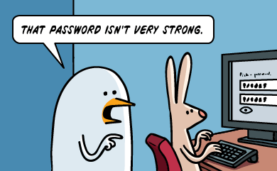

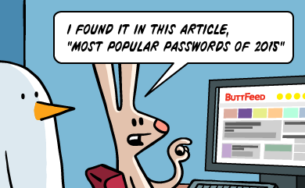

Slide 11
Password cracking (4)
Dictionary attack
  Most popular passwords 2014
123456
password
12345
12345678
qwerty
123456789
1234
baseball
dragon
football
11. 1234567
12. monkey
13. letmein
14. abc123
15. 111111
16.mustang
17. access
18. shadow
19. master
20. michael
Notes:
From http://gizmodo.com/the-25-most-popular-passwords-of-2014-were-all-doomed-1680596951
Although the source does not mention which of these passwords are used for sensitive information, and which for forced website registrations…

Slide 12
Password cracking (5)
Dictionary attack
  Although the use of security questions might be an even greater security leak...
  A small quiz:
    With one guess, an attacker’s probability of guessing English-speaking users’ answers to the question “What is your favorite food?” is?
      19.7%
    With ten guesses, what is the probability of an attacker to guess Korean-speaking users’ answers to “What is your city of birth?”
      39%
    How many guesses are required to obtain with 24% probability an Arabic-speaking users’ answers to “What’s your first teacher’s name?”
      10
  And the kicker
    40% of English-speaking users in the US couldn’t recall answers to their secret questions
Notes:
Many Secret Questions are less secure than the passwords they’re intended to act as a fail-safe for because they don’t operate with the same restrictions as passwords do:
Can you use special characters?
Is it case-sensitive?
Is there a minimum of characters that must be used?
Can you use at least 16 characters?
Is there a limit on the number of unsuccessful attempts?
In many cases, the answer to these questions is "no." The last one in particular makes Secret Questions incredibly easy to brute-force; if someone's trying to reset your password, he or she oftentimes has an infinite number of attempts to answer your secret question before ultimately cracking it.
More examples at http://androidcommunity.com/google-analyzes-answers-to-common-security-questions-20150526/
Safer questions include: what is your frequent flyer number?, what is your library card number?, etc.

Slide 13
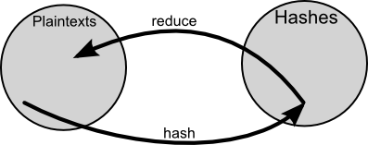
Password cracking (6)
Hash chains
  Hashing function H
    Same as password storage mechanism
  Reduction function R
    Transforms hash digest into a form that meets the password requirements
  Repeated several time, only the first and last password are stored
    Table containing numerous starting points and end points
Example chain
Example hash table entry
  Containing starting and last password
aaaaaa -> kiebgt
Notes:
Hash tables are constructed by hashing each word in a password dictionary, or by hashing all possible passwords. The password-hash pairs are stored in a table, sorted by hash value. To use a hash table, simple take the hash and perform a binary search in the table to find the original password, if it's present. However, where hash tables require an infeasible amount of memory once the password size increases, a hash chain offers a compromise for the memory/time trade-off, using less computer processing time and more storage than a brute-force attack which calculates a hash on every attempt, but more processing time and less storage than a simple lookup table with one entry per hash.
A hash chain is a precomputed table for reversing cryptographic hash functions, usually for cracking password hashes. Constructing a hash chain requires two things: a hashing function and a reduction function. The hashing function must match the hashing function used by the system from which you want to recover a password. The reduction function transforms the obtained hash into something usable as a password. Note, however, that the reduction function is not actually an inverse of the hash function: the only requirement for the reduction function is to be able to return a "plain text" value in a specific size. A simple example reduction function is to Base64 encode the hash, then truncate it to a certain number of characters. By alternating the hash function with the reduction function, chains of alternating passwords and hash values are formed. To generate the table, we choose a random set of initial passwords from P, compute chains of some fixed length k for each one, and store only the first and last password in each chain. The first password is called the starting point and the last one is called the endpoint. None of the intermediary passwords or hash digests is stored.

Slide 14
Password cracking (7)
Hash chains
  Reverse lookup:
    Find the corresponding end point
    Start reconstructing the chain that resulted in this end point
    Retrieve the intermediary password that resulted in the hash digest
Notes:
Now, given a hash value h that we want to invert (find the corresponding password for), compute a chain starting with h by applying R, then H, then R, and so on. If at any point we observe a value matching one of the endpoints in the table, we get the corresponding starting point and use it to recreate the chain. There's a good chance that this chain will contain the value h, and if so, the immediately preceding value in the chain is the password p that we seek. Since "kiebgt" is one of the endpoints in our table, we then take the corresponding starting password "aaaaaa" and follow its chain until 920ECF10 is reached. The password just before reaching this digest (“sgfnyd” in the example) is the one we are looking for.

Slide 15
Password cracking (8)
Hash chains: advantages
  Consumes less storage than pre-computed hash tables
    All passwords from the chain are represented as a single stored hash digest
    Lower memory requirements at the cost of more computation
    But still much faster than brute-force attacks
  Easily tweakable memory / time trade-offs
Notes:
The table content does not depend on the hash value to be inverted. It is created once and then repeatedly used for the lookups unmodified. The more links between the seed and the final value, the more passwords are captured. Increasing the length of the chain thereby decreasing the size of the table. However, it also increases the time required to perform lookups, and this is the time-memory trade-off of the table. In a simple case of one-item chains, the lookup is very fast, but the table is very big. Once chains get longer, the lookup slows down, but the table size goes down.

Slide 16
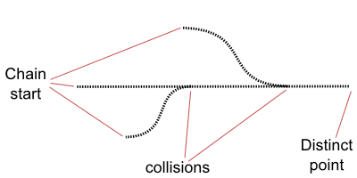
Password cracking (9)
Hash chains: disadvantages
  Can not be optimized for common passwords
  Difficult to select a suitable R function
      Needs to result in likely passwords
      E.g. needs to represent the likely distribution of passwords
  Coping with false alarms
    Another chain resulted in the same hash
    Example:
      Hash value FB107E70 also resulted in end point password kiebgt
      But FB107E70 is not part of starting chain aaaaaa
    Caused by colliding chains
      Most likely due to weak collision resistance of R
      Reduces the memory efficiency of the approach
      Difficult to detect since only start and end points are stored
Notes:
One first weakness is that the person building the chains doesn't choose the passwords they capture so the created tables can't be optimized for common passwords. Hash tables are good for common passwords (such as dictionary words), hash chains (or rainbow tables, see next slides) are good for tough passwords. The best approach is to recover as many passwords as possible using hash tables and/or conventional cracking with a dictionary of the top N passwords. For those that remain, use Rainbow Tables.
Also, it is important to choose a suitable function for R. Picking R to be the identity is little better than a brute force approach. Only when the attacker has a good idea of what the likely plaintexts will be he or she can choose a function R that makes sure time and space are only used for likely plaintexts, not the entire space of possible passwords. In effect R shepherds the results of prior hash calculations back to likely plaintexts but this benefit comes with drawback that R likely won't produce every possible plaintext in the class the attacker wishes to check denying certainty to the attacker that no passwords came from his chosen class. Also it can be difficult to design the function R to match the expected distribution of plaintexts.
Another problem is the occurrence of false alarms. The chain does not always contain the hash value h; it may so happen that the chain starting at h merges with the chain starting at the starting point at some point after h. For example, we may be given a hash value FB107E70, and when we follow its chain, we get the end point kiebgt. But FB107E70 is not in the chain starting at "aaaaaa". If at any point two chains collide (produce the same value), they will partly merge and consequently the table will not cover as many passwords despite having paid the same computational cost to generate. In this case, we ignore the match and continue to extend the chain of h looking for another match. If the chain of h gets extended to length k with no good matches, then the password was never produced in any of the chains. Because previous chains are not stored in their entirety, this is impossible to detect efficiently. For example, if the third value in chain 3 matches the second value in chain 7, the two chains will cover almost the same sequence of values, but their final values will not be the same. The hash function H is unlikely to produce collisions as it is usually considered an important security feature not to do so, but the reduction function R, because of its need to correctly cover the likely plaintexts, can not be collision resistant.

Slide 17
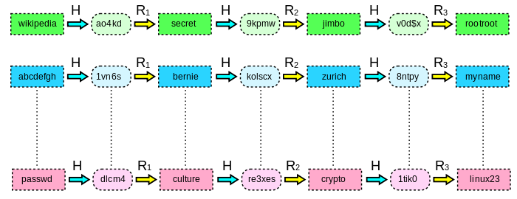
Password cracking (10)
Rainbow tables
  Table creation
    Avoid chain merges by using different reduction functions at each iteration
    Table merging only happens when the same value is obtained at the same iteration
Notes:
Rainbow tables effectively solve the problem of collisions with ordinary hash chains by replacing the single reduction function R with a sequence of related reduction functions R1 through Rk. In this way, for two chains to collide and merge they must hit the same value on the same iteration. Consequently, the final values in each chain will be identical. A final postprocessing pass can sort the chains in the table and remove any "duplicate" chains that have the same final value as other chains. New chains are then generated to fill out the table. These chains are not collision-free (they may overlap briefly) but they will not merge, drastically reducing the overall number of collisions.

Slide 18
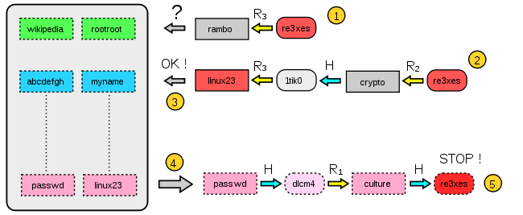
Password cracking (11)
Rainbow tables
  Password look-up process
    Apply the same procedure on the investigated hash
      Hash can be found at any iteration
      As such, generate k chains (k = maximum number of iterations in a chain)
  Significantly less tables needed
Notes:
Now, given a hash value h that we want to invert (find the corresponding password for), we again compute a chain starting with h by applying R, then H, then R, and so on. However, using sequences of reduction functions changes how the lookup procedure is performed: because the hash value of interest may be found at any location in the chain, it's necessary to generate k different chains. The first chain assumes the hash value is in the last hash position and just applies R_{k}; the next chain assumes the hash value is in the second-to-last hash position and applies R_{k−1}, then H, then R_{k}; and so on until the last chain, which applies all the reduction functions, alternating with H. This creates a new way of producing a false alarm: if we "guess" the position of the hash value wrong, we may needlessly evaluate a chain.
The look-up process is illustrated above
Starting from the hash ("re3xes"), one computes the last reduction used in the table and checks whether the password appears in the last column of the table (step 1).
If the test fails (rambo doesn't appear in the table), one computes a chain with the two last reductions (these two reductions are represented at step 2).
If this new test fails again, one continues with 3 reductions, 4 reductions, etc. until the password is found. If no chain contains the password, then the attack has failed.
However, if this test is positive (step 3, linux23 appears at the end of the chain and in the table), the password is retrieved at the beginning of the chain that produces linux23. Here we find passwd at the beginning of the corresponding chain stored in the table.
At this point (step 4), one generates a chain and compares at each iteration the hash with the target hash. The test is valid and we find the hash re3xes in the chain. The current password (culture) is the one that produced the whole chain: the attack is successful.
Although rainbow tables have to follow more chains, they make up for this by having fewer tables: simple hash chain tables cannot grow beyond a certain size without rapidly becoming inefficient due to merging chains. To deal with this, they maintain multiple tables, and each lookup must search through each table. Rainbow tables can achieve similar performance with tables that are k times larger, allowing them to perform a factor of k fewer lookups. Other advantages and disadvantages of this approach are the same ones as for the hash chains. Although creating a rainbow table is computationally expensive, the table can be reused during a long period, making it increasingly beneficial the longer the table is used.

Slide 19
Password cracking (12)
Counter approaches
  Reduce # of login attempts
    Use of captchas
    Max number of tries per time interval
  Increase attack time (on stored password digests)
    Key stretching functions
      Repeated invocations
      Complex cryptographic operation
    Specific password hashing functions
      Bcrypt, Argon2, ...
    Adding a salt
Notes:
Key stretching functions, such as PBKDF2, Bcrypt or Scrypt, typically use repeated invocations of a cryptographic hash to increase the time required to perform brute force attacks on stored password digests.
A suitable password hashing function, such as bcrypt, is many orders of magnitude better than a naive function like simple MD5 or SHA. In 2013 a "Password Hashing Competition" was announced to choose a new, standard algorithm for password hashing to avoid a repeat of previous password breaches involving weak or no hashing, such as the ones involving RockYou (2009), JIRA (2010), Gawker (2010), PlayStation Network outage (2011), EHarmony (2012), 2012 LinkedIn hack, Battlefield Heroes (2011), Adobe (2012), Evernote 2013, ASUS (2012), South Carolina Department of Revenue (2012), Ubuntu Forums (2013), etc. An open competition was organized to select one or more password hash functions that can be recognized as a recommended standard. In the wake of allegations that NSA forced NIST to standardize a backdoored algorithm (Dual EC DRBG), the competition was being run by an independent panel of cryptographers and security practitioners independent of NIST, in order to avoid even the appearance of a backdoored algorithm. On 20th July 2015 it selected Argon2 as a basis for the final PHC winner and gave special recognition to four other schemes: Catena, Lyra2, yescrypt and Makwa.

Slide 20
Passwords: Unix/Linux
Prevent table attacks by adding a “salt”
  The “salt” is a fixed number of bits, of which the value is determined at the time when the password is created
  The combination (“salt”, password) is encoded using a one way function
salt
password
1-way-
function
encoded
password
Notes:
The goal of this “salt” is that possibly identical passwords result in different encoded passwords, so that passwords must be tested individually. This is important, not only for systems with many users, but also for widely used systems. Without a salt the password storage system becomes vulnerable to techniques using pre-computed encoded passwords (e.g. rainbow tables) and birthday attacks. A rainbow table is ineffective against one-way hashes that include large salts.

Slide 21
Passwords: Unix/Linux
Easily accessible password file
  Passwords stored in /etc/password
  World-readable file
  So let’s just change access rights?
  Problem:
1 2 | [root@slashroot1 ~]# ls -l /etc/passwd -rw-r--r-- 1 root root 1875 Dec 14 23:17 /etc/passwd
1 2 3 4 | [root@slashroot1 ~]# chmod 600 /etc/passwd [root@slashroot1 ~]# ls -l /etc/passwd -rw------- 1 root root 1875 Dec 14 23:17 /etc/passwd [root@slashroot1 ~]#
1 2 3 4 5 | [root@slashroot1 ~]# su - sarath su: warning: cannot change directory to /home/sarath: Permission denied id: cannot find name for user ID 500 -bash: /home/sarath/.bash_profile: Permission denied
Notes:
You can see that there is an "r“ (Which stands for read), in all the three fields for that file. Let's try to change this permission, so that only "root" can read the file. Then let's see what's the effect of this change on the system...Let's try to become a normal user, and see what happens.
You can’t even change the user. Even if you change the user, you will not get the user name, home directory, custom shell, etc. (because all these details are stored in/etc/passwd). Due to this reason the file /etc/passwd, needs to be kept world readable. But we cannot keep passwords in a file that's world readable (because of the risk involved, even though its encoded in a one way hash algorithm). Hence there arises a need to separate passwords from this file and keep it in a file, that's only accessible by root. The solution to this problem is implemented in the form of a package in Linux called "shadow-utils".

Slide 22
Passwords: Linux
Improved version
  Longer “salt”: up to 96 bits
  Longer passwords can be chosen
  Old one-way function replaced by hash function (MD5) (applied several times)
    Or another one-way function (Blowfish, SHA-256, SHA-512, etc.)
  Password file replaced by shadow file “/etc/shadow”
    Only accessible to “root” user
    No longer accessible to outsiders
Notes:
The much longer “salt” makes the system also suitable for large numbers of users. The most important drawback of a freely accessible password file is that almost anyone could use this file to test passwords “off-line” using existing cracking software (such as “John The Ripper”, “Crack”, or rainbow tables). The advantage of a password file inaccessible to ordinary users is that the only way for an attacker to test passwords is attempting to log in (through SSH or FTP), or obtaining access to the system by some other means (e.g. through a security breach or physical access to the system). This is orders of magnitude less practical than running cracking software locally. Notice the system administrator still has access to the password file, meaning an internal attack using cracking software is still possible.

Slide 23
Passwords: Linux
Improved version
  Access rights
  Content
  Additional features
    Password restrictions, enforcing password changes, password ages, etc.
1 2 3 | [root@slashroot1 ~]# ls -l /etc/shadow -r-------- 1 root root 1140 Dec 14 23:17 /etc/shadow [root@slashroot1 ~]#
1 2 | [root@slashroot1 ~]# cat /etc/shadow root:$1$Etg2ExUZ$F9NTP7omafhKIlqaBMqng1:15651:0:99999:7:::
Hash function $ salt value $ hash
Notes:
The file itself contains several fields, separated by :
1. The first field is self explanatory, its the USERNAME
2. The second field is the encoded password describing the hashing algorithm, the salt value and the one way hash digest, all separated by dollar signs. The first entry describes the hashing algorithm:
$1 = MD5 hashing algorithm.
$2 =Blowfish Algorithm is in use.
$2a=eksblowfish Algorithm
$5 =SHA-256 Algorithm
$6 =SHA-512 Algorithm
3. The third field is the day's since the UNIX time that password was changed.
4. This field specifies the number of days, that are required between password changes.
5.No of days after which it is necessary to change the password.
6.This is the number of days before the required password change that the user gets a warning
7.If the password has expired, after this number of days the account will be disabled
8.No of days from the Unix Time that the account is disabled
9. This field is not used yet...
Additional fields are available because shadow-util's package provides more advanced feature's along with storing encoded passwords in /etc/shadow. The above mentioned fields of /etc/shadow, file allows to check and enforce e.g.
The age of the passwords and its expiry
Default parameters for user account creation (/etc/login.defs)
Tools to modify user accounts and groups
Enforcing strict password selection
…

Slide 24
Passwords
Remaining issues even with well-secured password storage
  Bad password choice
    Too short
    Login name
    Words (even in foreign languages), names, numbers
    Personal information
    Inversion of words, slight variations on words
    Etc.
  Compromised passwords
  Forgotten passwords
Notes:
Making it possible to use passwords of 15 characters and more doesn’t mean that users will grasp the opportunity of choosing long passwords. Passwords of 2 or 3 characters also occur: the eternal opposition between ease of use and security. Furthermore, a password can be compromised if it is used in an ill-secured or insecure context. It is therefore recommended to use different passwords for different categories of applications. For passwords granting system administrator access, it is even recommended to use a different password for each application.

Slide 25
Passwords
Choosing good passwords
  Sufficiently long
  Mixing small type and capitals
  Mixing letters and digits
  Including non-alphanumeric character
  Using passwords that are easy to remember, but hard to guess
    Using mnemotechnic aides
    Without releasing information about techniques used
  NEVER use a password encountered on some website

Slide 26
Passwords
Additional measures
  Imposing a strong password policy
    Using password strength evaluating software
      This software isn’t perfect, but it is at least a right step in the right direction
  Imposing regular password renewal (?)
    But allowing secure storage (e.g. using PGP)
    But beware of the risk of users starting to use <password>01, <password>02, etc.
      Balance between ease-of-use and security

Slide 27
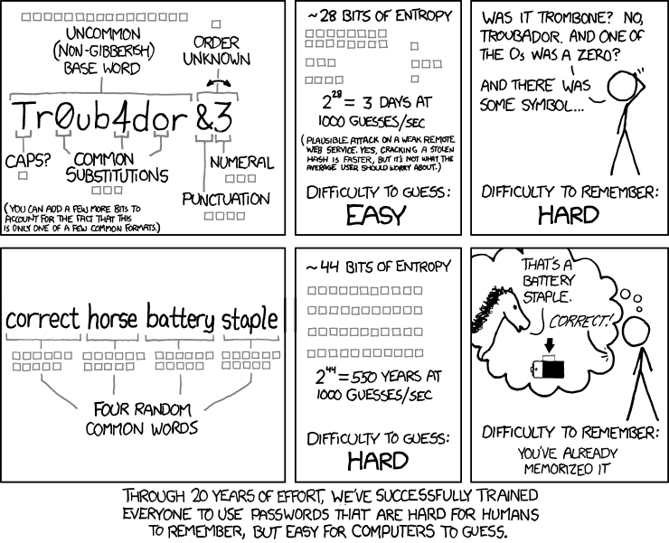
Passwords

Slide 28
Overview
Secure systems
  Authentication methods
    Passwords
    Biometry
    Security Tokens
  Trusted OS
  Disk encryption

Slide 29
Biometry
Methods for authentication
  Something the user knows:
    Password, PIN code, etc.
  Something the user owns:
    Sercret key, private key, etc.
  Something the user is:
    biometry

Slide 30
Biometry: types
Two categories
  Physical properties
    Fingerprint
    Iris scan
    Retina scan
    Hand shape
    Etc.
  Behavioural properties
    Voice recognition
    Movement during signature
    Etc.

Slide 31
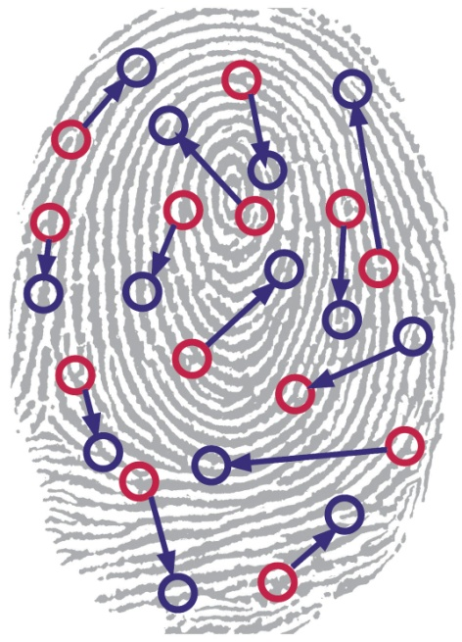
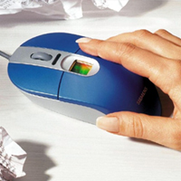
Biometry: fingerprint
Fingerprint
  Unique for each individual
Mouse with integrated
fingerprint scanner
source: Siemens
Notes:
The fine details of ridges, valleys, and swirls that define our fingerprints are influenced by random stresses experienced in the womb. Even a slightly different umbilical cord length changes your fingerprint. As such, even identical twins have different prints.

Slide 32
Biometry: fingerprint (2)
Disadvantages
  Easy to obtain
    Not secret
      Imprinted on keyboards, mugs, screens, ...
      Can even be identified from photographs!
    Can be recreated
  Non revocable
    Once known, impossible to use in the future
  Not hashable
    Small variations are to be expected, so the full fingerprint information needs to be stored
    Impossible to add salt functions

Slide 33
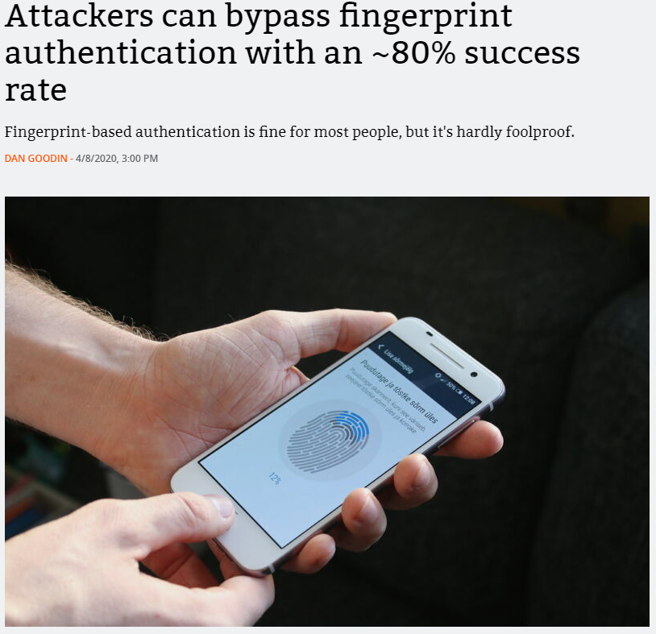

Biometry: fingerprint (3)
Disadvantages
https://arstechnica.com/information-technology/2020/04/attackers-can-bypass-fingerprint-authentication-with-an-80-success-rate/
Notes:
Obtaining and reproducing fingerprints poses no challenge. An example technique of fingerprint recreation etches a copy of a fingerprint into copper (as if making a PCB), coating the etching in graphite spray, and finally topping it all off with a layer of wood glue or latex. Where the copper is etched away, the glue-and-graphite finger mold is deeper, simulating the ridges on your finger. The graphite spray is used to give the model the right bulk capacitance. As a result, back when the iPhone 5’s touchID system was just announced, it was hacked after only 2 days.
A video describing the methods used can be found at http://arstechnica.com/security/2013/09/touchid-hack-was-no-challenge-at-all-hacker-tells-ars/
An in-depth explanation can be found on https://arstechnica.com/information-technology/2020/04/attackers-can-bypass-fingerprint-authentication-with-an-80-success-rate/

Slide 34
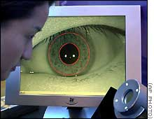
Biometry: iris
Iris around pupil
  Exhibits complex pattern, unique for each individual
    Isn’t altered by time
source: CNN 2002-03-27

Slide 35
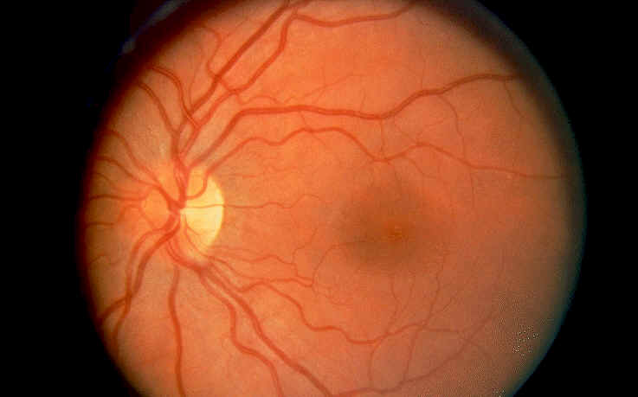
Biometry: retina
Retina
  Unique pattern of blood vessels
    May however be altered by some ocular affections
source: http://www.eyesearch.com/

Slide 36
Biometry: advantages
Advantages
  Strong authentication of user identity
  Not transmissible
    And therefore not stealable (?)
  Fast and easy to use
    At least, this is the intent

Slide 37
Biometry: drawbacks
Drawbacks
  Accuracy
    Too lax: security risk
    Too stringent: reduced ease-of-use
  Social acceptation
    OK for finger print recognition
    Less OK for iris or retina scan
  Privacy
    Hard linked to identity
  Suitable for persons with disabilities?
Notes:
Biometric characteristics such as a fingerprint are never measured twice in a row in exactly the same way (orientation of a finger may differ, etc.). This means that some error tolerance must be accepted for the recognition function. If the error tolerance is too large, users will wrongly obtain access (which implies a security risk). If the error tolerance is too small, legitimate users will wrongly be denied access, which can generate non-negligible irritation if this happens too often. These accuracy issues often strongly depend on the method: iris recognition is much less problematic than fingerprint recognition. The larger the number of legitimate users, the larger the risk of wrongly recognising a non-legitimate user.

Slide 38
Biometry: drawbacks
Drawbacks
  Sometimes lacking openness
    Against Kerckhoff’s principle
  Not all systems are equally secured against abuse
    Biometric information is not secret
    Issue of how to protect data that must be recognised
  Not replaceable
Notes:
Biometric systems are often much less unbreakable than producers claim (fingerprints can be forged). Simply replacing the login/password system isn’t obvious. A normal password must be stored encoded on the system and at login the input password in encoded and compared to the stored encoded password. Because of the error margin which must be accepted for biometric data, a comparable approach isn’t possible. This means we need special security for the stored biometric data. Physical protection of the input device is necessary, so that the recognition can take place on the input device itself (and not on the PC).

Slide 39
Overview
Secure systems
  Authentication methods
    Passwords
    Biometry
    Security Tokens
  Trusted OS
  Disk encryption

Slide 40
Security tokens
Less dependent on host security
  Storage of secret/private keys outside the host
    Secret/private key computations are performed on token itself, not on host
    Unencrypted keys are never present on host
    Almost inaccessible to malware
  Typically two factor authentication (2FA)
    PIN code for access to token
      And access is blocked if too many consecutive failed attempts
    Authentication by token
    Limited risk when lost/stolen
      Easier to protect physical object than to protect combination password/passphrase + PIN code
Notes:
Even when using secure storage solutions, at some times the secret or private key must be available: during the symmetric encryption or decryption process, during the asymmetric decryption process, when applying a digital signature, when computing a message authentication code, etc. At these moments, the unencrypted key will be present in the memory of the end system. Well-designed security programs will take care that this part of memory cannot be swapped to disk by the operating system (“locking” in memory) and that the memory used will be erased before being released, so that another program cannot misuse the memory contents to retrieve confidential information. However, sufficiently clever malware will still be able to bypass these security measures, e.g. by logging the password that was input at the keyboard.
Two factor authentication enhances the provided security by requiring multiple access methods of different types. In the case of security tokens, access is only granted based on what you know (e.g. the passphrase) and what you own (the token). Other two factor authentication methods use e.g. other combinations of information you know (passsword, PIN, etc.), possess (SIM card, token, etc,) or characteristics you exhibit (voice, iris patterns, etc.)

Slide 41
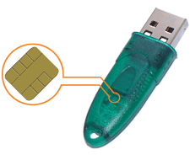
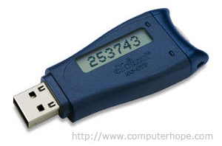
Security tokens
Physically connected to host
  Token performs cryptographic calculations on message received from host
    Encryption/decryption
      Sends back encrypted/decrypted message
    Digital signature
      Sends back digital signature of message
    Etc.
  (Limited) vulnerability to malicious (or infected) host
    E.g. generation of undesirable digital signatures

Slide 42
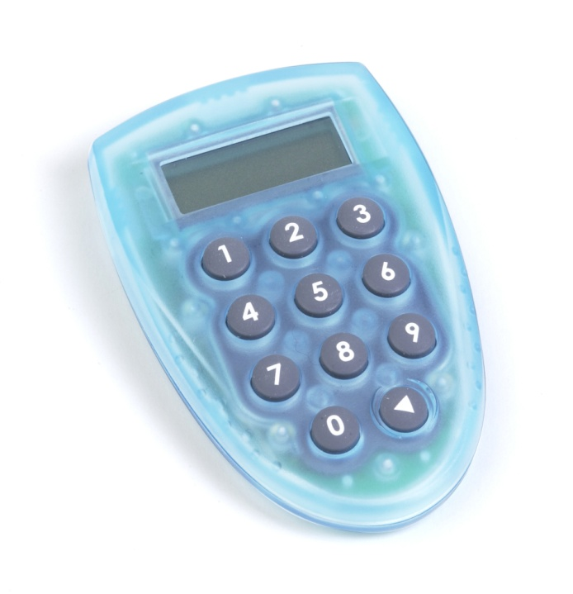
Security tokens
Not physically connected to host
  Usually much more limited input and output
    Digits (using limited keyboard and screen)
    Sometimes without any input at all
  E.g.:

Slide 43
Security tokens
Not physically connected to host
  Token with input
    Usually secured by PIN code (2FA)
    Typically generates a cryptographic random number
      Sometimes as a response to website challenge
        Sometimes derived from counter, guaranteeing unique responses
      Sometimes time-dependent
        Requires synchronising server clock and token clock
      To be used as unique password
  Token without input
    Typically generates a cryptographic random number
      Time dependent
        Requires synchronising server clock and token clock
      Depends on some token specific secret key
      To be used as unique password
    Often used in combination with some other user authentication system
      E.g. password
Notes:
Note that with a well-chosen challenge, replay attacks are implausible. The only risk is that the “responses” of your token to all possible “challenges” are known by the attacker. As the number of “challenges” is limited (e.g. 10⁶), it cannot be fully ruled out. The situation can be improved by requiring to input more than 1 “challenge” (at the cost of diminished user friendliness). An alternative is to make the “response” time dependent or to include a counter mechanism.

Slide 44
Security tokens
Not physically connected to host
  Advantages
    Less vulnerable to malware on host
      End user must act to use the token
  Disadvantages
    Remaining vulnerabilities
      Phishing
      Hacked token manufacturer
    End user has no trace of actions performed
      Possible issue for non-repudiation
    No encryption capacity
    Requires more interaction from end user

Slide 45
Security tokens
Limitations
  Lost/stolen token may be cracked
    Enabling access to stored keys and/or PIN code
    Cracking the key may be possible using side-channel attacks
      E.g. time analysis, power analysis, fault injection
      So secure PIN code may still prove critical
    “Tamper-proof”
      Definitely a desirable property…
      …but very hard to achieve

Slide 46
Overview
Secure systems
  Authentication methods
  Trusted OS
  Disk encryption

Slide 47
“Secure” Vs. “Trust”
Word secure reflects a dichotomy:
  Something is either secure or not secure.
On the other hand “trust” gives allowance for approximations.
  E.g., trust implies meets current security requirements (cannot speak to about the future).
Secure | Trusted
Either-or: something either is or is not secure | Graded: There are degrees of “trustworthiness
Asserted based on product characteristics | Judged based on evidence and analysis
Absolute: not qualified as to how, where, when, or by whom used | Relative: viewed in context of use
A goal | A characteristic

Slide 48
Trustworthy OS
An OS is trusted if it provides:
  Memory protection
  Generation object access control
  User authentication
In a consistent and effective manner.
Before we can determine if an OS is trusted:
  We must state a policy.
    Security policy: statement of the security we expect the system to enforce.
  Define formal models that tell us the conditions to assure the policy succeeds.

Slide 49
Overview
Secure systems
  Authentication methods
  Trusted OS
    Policies
    Access control
    OS kernel
  Disk encryption

Slide 50
Military Security policy
Existing policies (confidentiality, integrity, availability) remain but can be extended
  E.g. Military security policy “need to know”.
Information falls under different degrees of sensitivity:
  Unclassified to top secret.
  Each sensitivity is determined by a rank. E.g., unclassified has rank 0.
Unclassified
Restricted
Confidential
Secret
Top
Secret
Notes:
A security clearance is a status granted to individuals allowing them access to classified information (state or organizational secrets) or to restricted areas, after completion of a thorough background check. The term "security clearance" is also sometimes used in private organizations that have a formal process to vet employees for access to sensitive information.
Top Secret is applied to information that reasonably could be expected to cause exceptionally grave damage to the national security if disclosed to unauthorized sources.
This level needs to be reinvestigated every 5 years.*
Secret is applied to information that reasonably could be expected to cause serious damage to the national security if disclosed to unauthorized sources.
This level is reinvestigated every 10 years.*
Confidential is applied to information that reasonably could be expected to cause damage to the national security if disclosed to unauthorized sources. The vast majority of military personnel are given this very basic level of clearance.
This level needs to be reinvestigated every 15 years.*
Material that is classified as Restricted (or “For Official Use Only (U//FOUO))” is considered between Unclassified and Confidential and may deal with employee data.
Unclassified is a valid security description, especially when indicating unclassified information within a document classified at a higher level. For example, the title of a Secret report is often unclassified, and must be marked as such.
* Reinvestigations are more important than the original investigation because those individuals who have held clearances longer are more likely to be working with increasingly critical information.

Slide 51
Overview
Secure systems
  Authentication methods
  Trusted OS
    Policies
    Access control
    OS kernel
  Disk encryption

Slide 52
Access to Information
Compartment: Each piece of classified information may be associated with one or more projects called compartments
  <rank; compartments>
Compartment 1
Top Secret
Secret
Compartment 2
Compartment 3
Confidential
Restricted
Unclassified
Notes:
A clearance by itself is normally not sufficient to gain access; the organization must also determine that the cleared individual needs to know specific information (“need to known base”). No one is supposed to be granted automatic access to classified information solely because of rank, position, or a security clearance.

Slide 53
Dominance relation
Clearance:
  A person seeking access to sensitive information must be cleared.
  Expressed as a combination: <rank; compartments>
Consider subject s and an object o.
  s <= o if an only if:
    rank_s <= rank_o and
    compartments_s is a subset of compartments_o
E.g. a subject can read an object only if:
  The clearance level of the subject is at least as high as that of the information and
  The subject has a need to know about all compartments for which the information is classified.
  E.g.information <secret, {Sweden}> can be read by someone with clearance: <top_secret, {Sweden}> and <secret , {Sweden}> but not by <top_secret, {Crypto}>

Slide 54
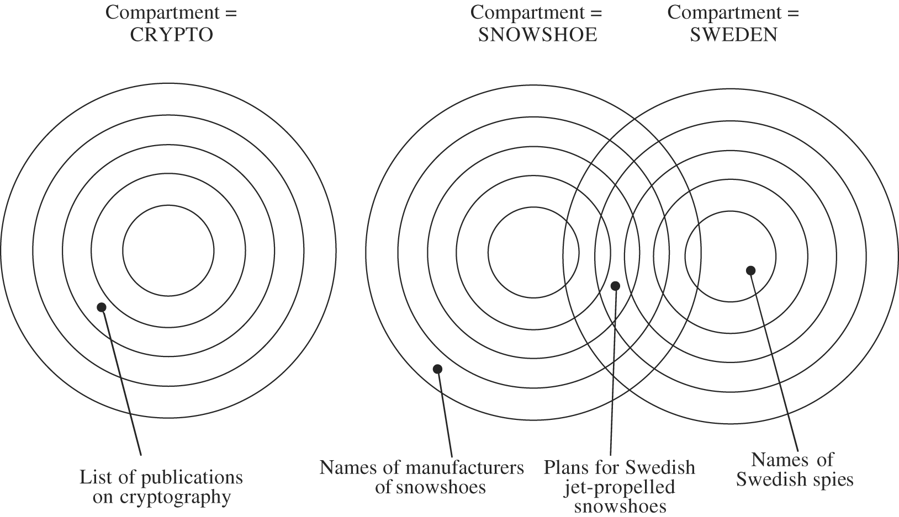
Access to Information
A single piece of information may belong to multiple compartments
Notes:
A particular project may need to use information which is both top secret and secret. . In this case, a solution is the creation of a compartment to cover the information in both. This compartment may include information across multiple sensitivity levels.

Slide 55
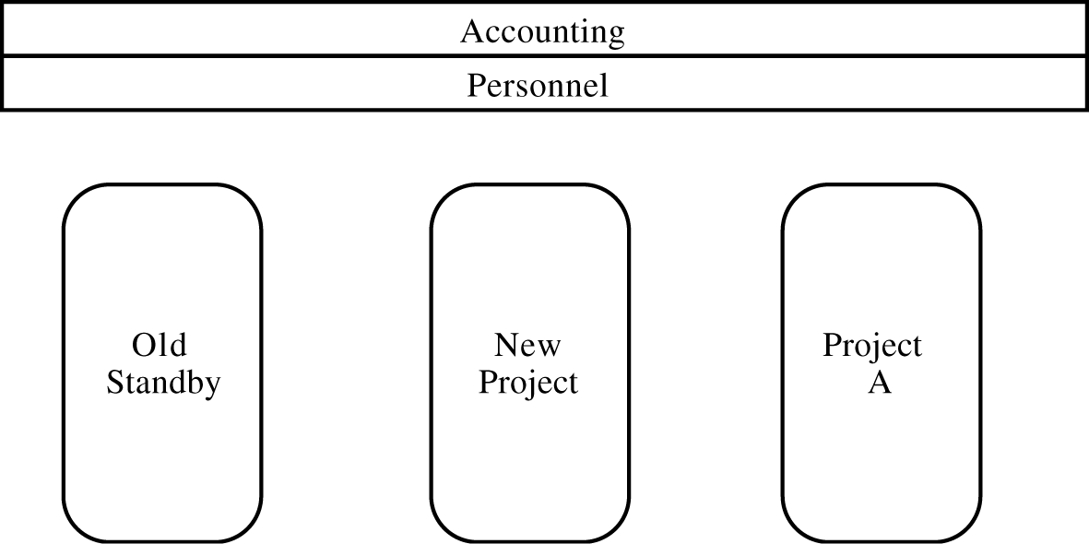
Access to Information
Similar constraints can exist in commercial systems

Slide 56
Access control models
Discretionary Access Control (DAC)
  The user creating a resource is its owner.
  The owner determines the authorized users of that resource
    Access rights and permissions
Mandatory Access Control (MAC)
  An “administrator” determines authorizations.
    A person who creates a resource is not the owner of the resource and does not determine the authorizations.
  Mandatory use of rules or labels
Role-based access control (RBAC)
  Like MAC, the administrator determines authorizations
  Every user is assigned different roles. A user is logged into one role at any given time.
    Authorizations are given to roles.
Notes:
Access control models are sometimes categorized as either discretionary or non-discretionary. The three most widely recognized models are Discretionary Access Control (DAC), Mandatory Access Control (MAC), and Role Based Access Control (RBAC).
Discretionary access control (DAC) is a policy determined by the owner of an object. The owner decides who is allowed to access the object, and what privileges they have.
Two important concepts in DAC are
File and data ownership: Every object in the system has an owner. In most DAC systems, each object's initial owner is the subject that caused it to be created. The access policy for an object is determined by its owner.
Access rights and permissions: These are the controls that an owner can assign to other subjects for specific resources.
Mandatory access control (MAC) refers to allowing access to a resource if and only if rules exist that allow a given user to access the resource. The term mandatory has historically implied a very high degree of robustness that assures that the control mechanisms resist subversion, thereby enabling them to enforce an access control policy that is mandated by some regulation that must be absolutely enforced. It is more difficult to manage, but its use is usually justified when used to protect highly sensitive information. Examples include certain government and military information. Management is often simplified (over what can be required) if the information can be protected using hierarchical access control, or by implementing sensitivity labels. In such a system subjects and objects must have labels assigned to them. A subject's sensitivity label specifies its level of trust. An object's sensitivity label specifies the level of trust required for access. In order to access a given object, the subject must have a sensitivity level equal to or higher than the requested object. Controlling the import of information from other systems and export to other systems (including printers) is a critical function of these systems, which must ensure that sensitivity labels are properly maintained and implemented so that sensitive information is appropriately protected at all times.
Role-based access control (RBAC) is also an access policy determined by the system, not by the owner. RBAC is used in commercial applications and also in military systems, where multi-level security requirements may also exist. It can be distinguished from MAC primarily in the way permissions are handled. MAC controls read and write permissions based on a user's clearance level and additional labels. RBAC controls collections of permissions that may include complex operations such as an e-commerce transaction, or may be as simple as read or write. Within an organization, roles are created for various job functions. The permissions to perform certain operations are assigned to specific roles. Members or staff (or other system users) are assigned particular roles, and through those role assignments acquire the computer permissions to perform particular computer-system functions. Since users are not assigned permissions directly, but only acquire them through their role (or roles), management of individual user rights becomes a matter of simply assigning appropriate roles to the user's account; this simplifies common operations, such as adding a user, or changing a user's department. A role in RBAC can be viewed as a set of permissions.

Slide 57
Overview
Secure systems
  Authentication methods
  Trusted OS
    Policies
    Access control
    OS kernel
  Disk encryption

Slide 58
OS Functions
OS kernel:
  part that performs lowest level functions
User tasks
OS
OS Kernel
Hardware

Slide 59
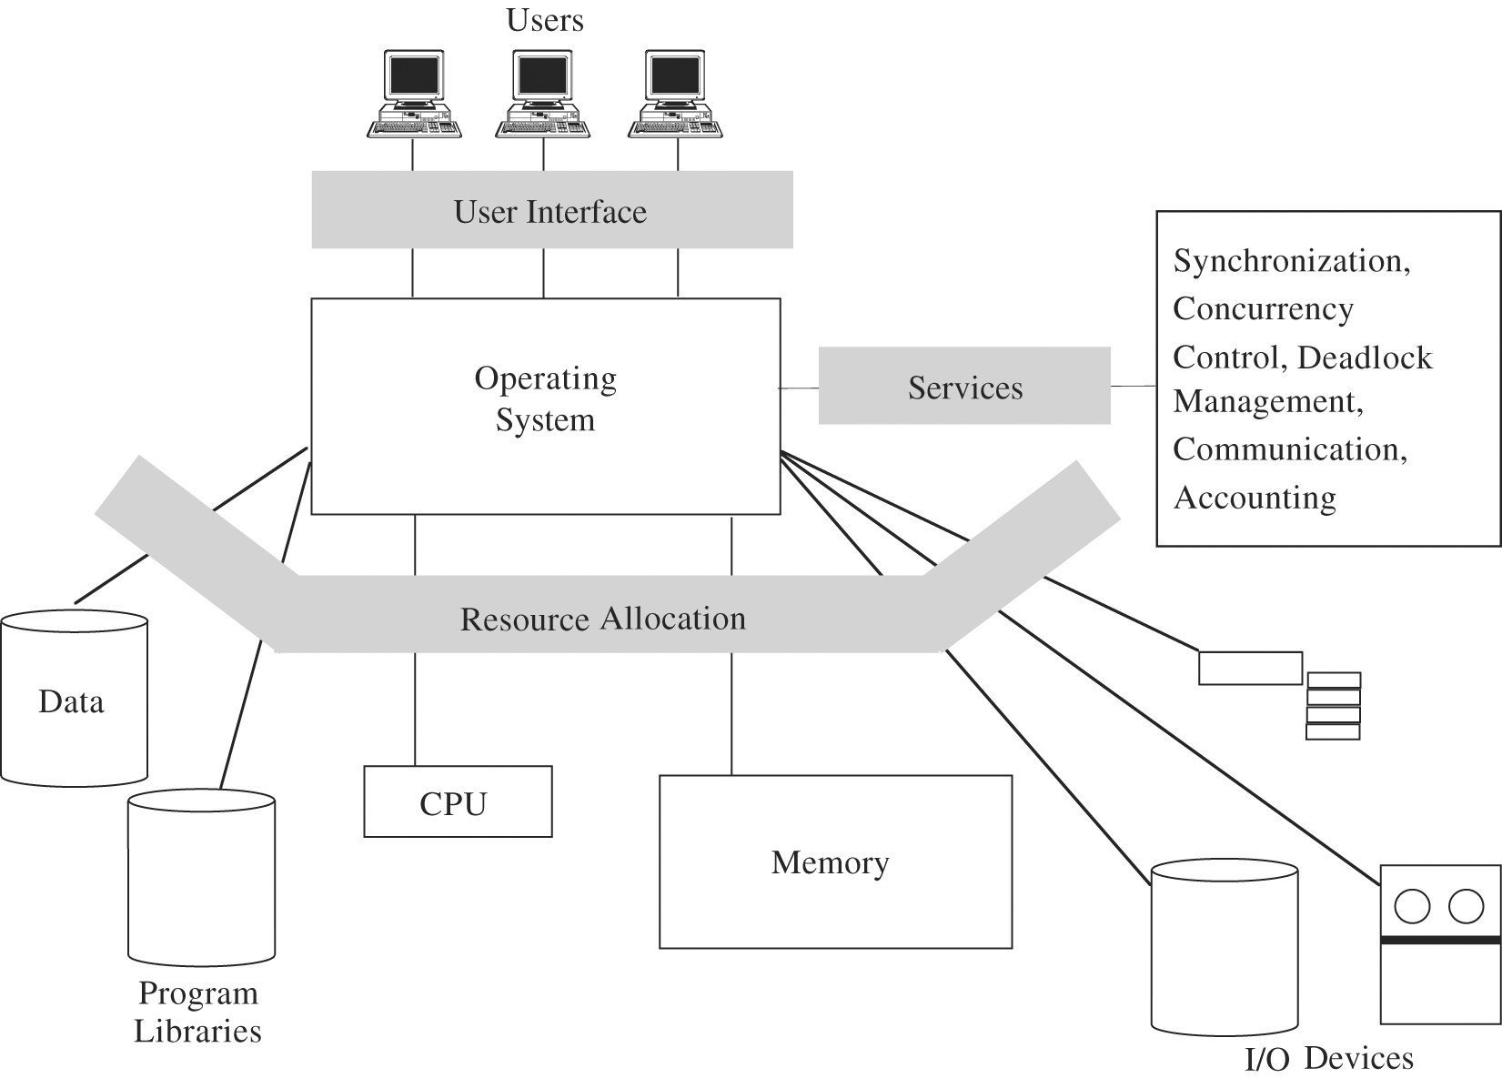
OS Functions

Slide 60
Security features in ordinary OS
Authentication of users
  password comparison
Protection of memory
  user space, paging, segmentations
File and I/O device access control
  access control matrix
Allocation & access control to general objects
  table lookup
Enforcement of sharing
  integrity, consistency
Fair service
  no starvation
Inter process communication & synchronization
  table lookup
Protection of OS protection data
  encryption, hardware control, isolation

Slide 61
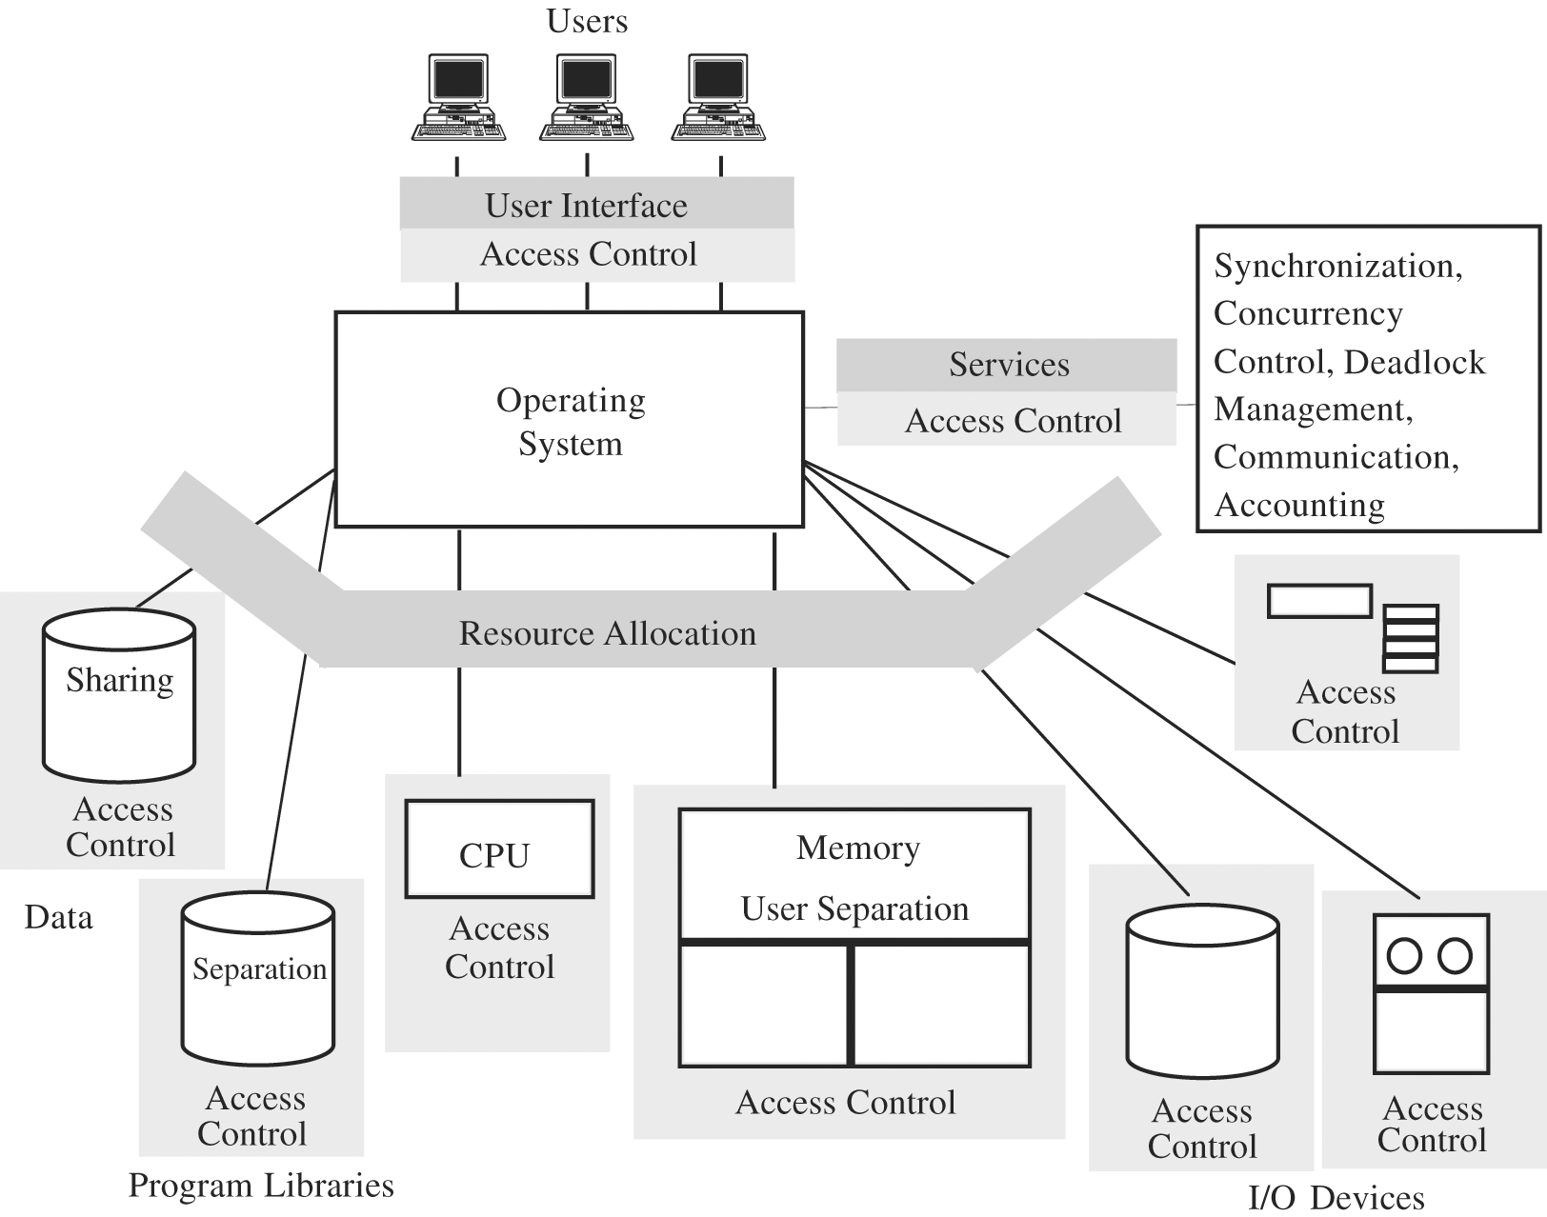
Trusted OS Functions

Slide 62
Security features of Trusted OS
Design features
Coverage
  ensure that every access is checked
Separation
  security mechanisms are isolated from the rest of OS and from user space → easier to protect
Unity
  all security mechanisms are performed by a single set of code → easier to trace problems
Modifiability
  security mechanism changes are easier to make and test
Compactness
  relatively small
Verifiability
  formal methods, all situations are covered

Slide 63
Reference Monitor
Trusted Computing Base (TCB)
  Everything in the trusted OS necessary to enforce security policy
Reference monitor
  Portion of a TCB that controls accesses to objects
  Collection of access controls for
    Devices, Files, Memory, Interprocess communication, Other objects
  Must be
    Always invoked when any object is accessed
    Small enough
      analysis, testing
    Tamperproof
O
O
O
Gate
S
S
S
Notes:
The trusted computing base (TCB) of a computer system is the set of all hardware, firmware, and/or software components that are critical to its security, in the sense that bugs or vulnerabilities occurring inside the TCB might jeopardize the security properties of the entire system. By contrast, parts of a computer system outside the TCB must not be able to misbehave in a way that would leak any more privileges than are granted to them in accordance to the security policy. The Orange Book, a classic computer security literature reference, describes the TCB of a computer system, as “the totality of protection mechanisms within it, including hardware, firmware, and software, the combination of which is responsible for enforcing a computer security policy”. In other words, a given piece of hardware or software is a part of the TCB if and only if it has been designed to be a part of the mechanism that provides its security to the computer system. In operating systems, this typically consists of the kernel (or microkernel) and a select set of system utilities (for example, setuid programs and daemons in UNIX systems)

Slide 64
Combined Security Kernel / OS System
OS Kernel:
- HW interactions
- Access control
User tasks
OS
OS Kernel
Hardware
OS:
Resource allocation
Sharing
Access control
Authentication
functions
Security activity

Slide 65
Separate Security Kernel
OS Kernel:
- HW interactions
- Access control
User tasks
OS
Security Kernel
Hardware
OS:
Resource allocation
Sharing
Access control
Authentication
functions

Slide 66
Layered OS
User processes
Compilers, database
Utility functions
OS
File system, device allocation
Scheduling, sharing, MM
Synchronization, allocation
OS kernel
Security functions
Security kernel
Hardware

Slide 67
Virtualization
Virtualization is used to provide logical separation that gives the user the impression of physical separation
  OS emulates or simulates a collection of a computer system’s resources
    processor, memory, I/O devices
  Each user feels that he/she has a separate machine
Virtual
Machine
User 1
Virtual
Machine
User 2
Virtual
Machine
User 3
Real OS
Real System Resources

Slide 68
Overview
Secure systems
  Authentication methods
  Trusted OS
  Disk encryption

Slide 69
Disk encryption
Safeguard against physical capture of a disk
  Can be part of the OS or added through separate applications
  Possible in all major operating systems
Approaches
  Manual
  File system-level
  Full disk encryption
Notes:
Manual encryption requires an active choice from the user to encrypt or decrypt specific files or directories. In contrast, in filesystem-system level encryption, Individual files or directories are encrypted & decrypted by the file system itself, which is often performed as of the OS. Finally, full disk encryption approaches encrypt the full system (sometimes including boot sector). These last approaches are typically implemented below OS level.

Slide 70
Disk encryption
Filesystem-level encryption
  Advantages
    Includes separate key usage per file
    Per file backup possible (in encrypted form)
    Integration of access control features
  Implementations
    General purpose file system
      Does not encrypt metadata
    Cryptographic file systems
      Designed for security
      Often layered on top of existing file systems
Notes:
In contrast to full disk encryption, filesystem-level encryption, often called file/folder encryption, is a form of disk encryption where individual files or directories are encrypted by the file system itself.
General-purpose file systems that include filesystem-level encryption do not typically encrypt file system metadata, such as the directory structure, file names, sizes or modification timestamps. This can be problematic if the metadata itself needs to be kept confidential. In other words, if files are stored with identifying file names, anyone who has access to the physical disk can know which documents are stored on the disk, although not the contents of the documents. One exception to this is the encryption support being added to the ZFS filesystem. Filesystem metadata such as filenames, ownership, ACLs, extended attributes are all stored encrypted on disk. The ZFS metadata relating to the storage pool is stored in plaintext, so it is possible to determine how many filesystems (datasets) are available in the pool, including which ones are encrypted. The content of the stored files and directories remain encrypted.
Cryptographic file systems are specialized (not general-purpose) file systems that are specifically designed with encryption and security in mind. They usually encrypt all the data they contain – including metadata. Instead of implementing an on-disk format and their own block allocation, these file systems are often layered on top of existing file systems e.g. residing in a directory on a host file system. Many such file systems also offer advanced features, such as deniable encryption, cryptographically secure read-only file system permissions and different views of the directory structure depending on the key or user. One use for a cryptographic file system is when part of an existing file system is synchronized with 'cloud storage'. In such cases the cryptographic file system could be 'stacked' on top, to help protect data confidentiality.

Slide 71
Disk encryption
Full disk encryption
  Advantages
    Encrypts full disk
      Including temporary files, metadata, OS and (sometimes) bootstrapping code
    Users can not accidently forget to encrypt a file
    Easy to destroy the data
  Weaknesses
    Cold boot attacks
    Side channel attacks
      Key loggers, acoustic, …
Notes:
Full disk encryption has several benefits compared to regular file or folder encryption, or encrypted vaults. The following are some benefits of disk encryption.
Nearly everything including the swap space and the temporary files is encrypted. Encrypting these files is important, as they can reveal important confidential data. With a software implementation, the bootstrapping code cannot be encrypted however. (For example, BitLocker Drive Encryption leaves an unencrypted volume to boot from, while the volume containing the operating system is fully encrypted.)
With full disk encryption, the decision of which individual files to encrypt is not left up to users' discretion. This is important for situations in which users might not want or might forget to encrypt sensitive files.
Immediate data destruction, such as simply destroying the cryptographic keys, renders the contained data useless.
Weaknesses
Most full disk encryption schemes are vulnerable to a cold boot attack, whereby encryption keys can be stolen by cold-booting a machine already running an operating system, then dumping the contents of memory before the data disappears. The attack relies on the data remanence property of computer memory, whereby data bits can take up to several minutes to degrade after power has been removed. Even a Trusted Platform Module (TPM) is not effective against the attack, as the operating system needs to hold the decryption keys in memory in order to access the disk.
All software-based encryption systems are vulnerable to various side channel attacks such as acoustic cryptanalysis and hardware keyloggers. In contrast, self-encrypting drives are not vulnerable to these attacks since the hardware encryption key never leaves the disk controller.

Slide 72
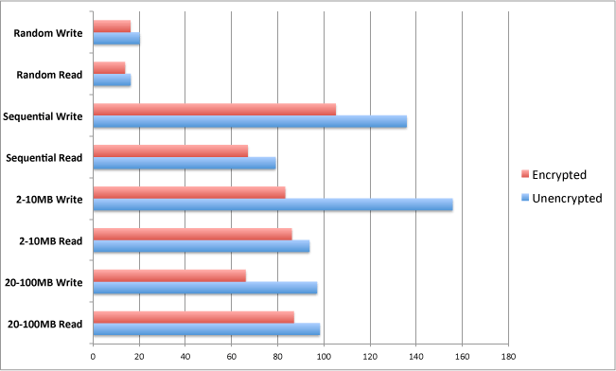
Disk encryption
Full disk encryption
  MAC OS X 10.7 filevault performance impact
Notes:
From http://www.maclive.net/macosx107lionfilevaultwholediskencryptionbenchmarkcomparison/

Slide 73
Disk encryption
Possible features
  Plausible denial
  Hidden containers
  Pre-boot authentication
  Single sign-on
  Custom authentication
  Multiple keys
  Passphrase strengthening
  Hardware acceleration
  Trusted Platform Module
  Filesystems
  Two-factor authentication
  Boot sector encryption
Notes:
Plausibly deniability: describes encryption techniques where the existence of an encrypted file or message is deniable in the sense that an adversary cannot prove that the plaintext data exists.
Hidden containers: Includes hidden containers (an encrypted container (A) within another encrypted container (B) so the existence of container A can not be established) that are created for deniable encryption.
Pre-boot authentication: Whether authentication can be required before booting the computer, thus allowing one to encrypt the boot disk. One issue to address in full disk encryption is that the blocks where the operating system is stored must be decrypted before the OS can boot, meaning that the key has to be available before there is a user interface to ask for a password. Most Full Disk Encryption solutions utilize Pre-Boot Authentication by loading a small, highly secure operating system which is strictly locked down and hashed versus system variables to check for the integrity of the Pre-Boot kernel.
Single sign-on: Whether credentials provided during pre-boot authentication will automatically log the user into the host operating system, thus preventing password fatigue and reducing the need to remember multiple passwords.
Custom authentication: Whether custom authentication mechanisms can be implemented with third-party applications.
Multiple keys: Whether an encrypted volume can have more than one active key. Sometimes, one key is used to destroy all data on the disk when used, or to boot in such a way that only containers which do not contain sensitive information are shown.
Passphrase strengthening: Whether key strengthening is used with plain text passwords to frustrate dictionary attacks, usually using PBKDF2.
Hardware acceleration: Whether dedicated cryptographic accelerator expansion cards can be taken advantage of.
Trusted Platform Module: Trusted Platform Module (TPM) is a secure cryptoprocessor embedded in the motherboard that can be used to authenticate a hardware device. Since each TPM chip is unique to a particular device, it is capable of performing platform authentication. It can be used to verify that the system seeking the access is the expected system. A limited number of disk encryption solutions have support for TPM. These implementations can wrap the decryption key using the TPM, thus tying the hard disk drive (HDD) to a particular device. If the HDD is removed from that particular device and placed in another, the decryption process will fail. Recovery is possible with the decryption password or token.
Filesystems: what filesystems are supported.
Two-factor authentication: Whether optional security tokens (hardware security modules, such as Aladdin eToken and smart cards) are supported (for example using PKCS#11)
Boot sector encryption: Whole disk encryption often signify that everything on disk is encrypted – including the programs that can encrypt bootable operating system partitions – when part of the disk is necessarily not encrypted. On systems that use a master boot record (MBR), that part of the disk remains non encrypted. Some hardware-based full disk encryption systems can truly encrypt an entire boot disk, including the MBR.

Slide 74
Test yourself
What are the advantages and disadvantages of increasing the length of hash chains / rainbow tables?
Explain the major differences between hash chains and rainbow tables.
What is 2-factor authentication?
What are the security advantages of using security tokens vs software based approaches?
Which are the advantages of using full disk encryption vs manual encryption?

